Slide 1
NEA task 3 - Research

Slide 2
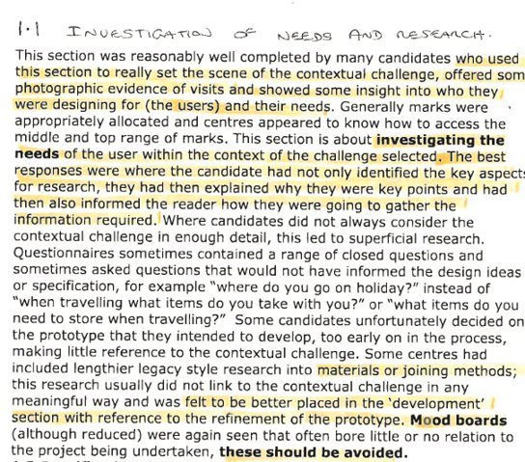
Excerpt from examiner feedback
The key things to include;
Hopefully you have by now made a list of the things you need to research; this would have been based on the information in your spider diagrams and what you have found out on your first page by exploring the content.
Quote;
'The best responses were where the candidate had not only identified the key aspect for research, they had then explained why they were key points and had then also informed the reader how they were going to gather the information required.'
You now need to carry out this research!
Have photographs showing the location / venue – show the examiner where this product is going to be placed / used / interacted with...D.T. Teachers are very visual people...they prefer bullet points, sketches and photographs to paragraphs....the easier it is to mark for the examiner, the more likely he is going to give you the marks. If you can't visit the venue, use the internet for now and explain to the examiner in your portfolio why you cannot yet visit and that you plan to as soon as it is allowed.
Carry out more in-depth research on the user...this could include some ergonomics, an interview etc... To quote you should be researching the 'user within the context of the challenge selected;'
Also, don't forget that you will need to research existing products...you also would benefit from getting a client / user feedback along with the product research; it reinforces the user needs.

Slide 3
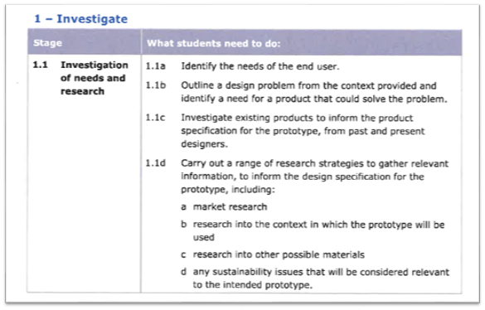
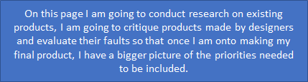
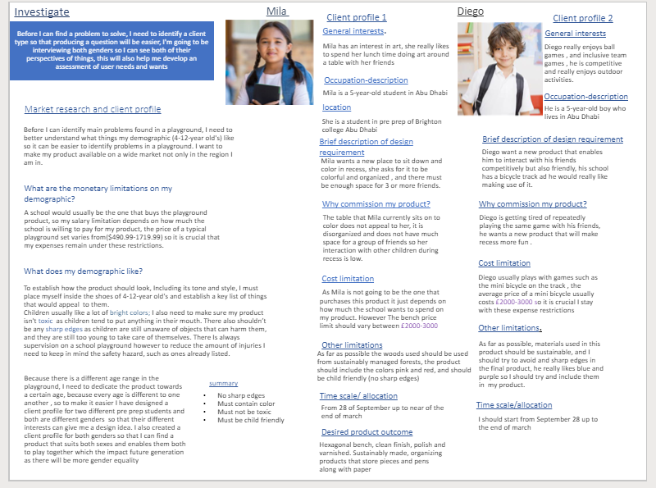
Excerpt from the 'important points to include' document.
As mentioned in the last PowerPoint, Matilde quoted these points as numbers. If you look at Maya's Portfolio, she just told the examiner what she was doing on each page...have a look; it's in a blue box.
As part of your investigation you will be considering all these points given by the exam board.
1.1a starts with the client research, it also appears in the existing products, ergonomics and in fact on most pages. All your research is about identifying the needs of the end user.
Just look at the example portfolios and you will see this.
Maya researched needs of the end user over pages 3 – 15 in her portfolio

Slide 4

Excerpt from the 'important points to include' document.
1.1b is a discussion on your first page, and is followed through as a story of discovery throughout your research...remember the video (again)?
The need for a product needs to be made clear. It is better to tell the story of how you found the need. It is explained clearly in the video. It all started with an accident....

Slide 5
Excerpt from the 'important points to include' document.
1.1c This starts with existing products, but then you may also be looking later at components. It is worth writing a conclusion on each page of your research...what have you found out that could be used in a specification?
-remember that I have already suggested that you start writing your specification table as you complete your research. It will make it easier for you as you go along.
1.1d It is up to you on how you go about researching these points. Some of them come up in development too. Everyone will be following a different iterative journey. However, if you want the marks at the end of the journey (in August when your GCSE results are published) you will need to fulfil them.

Slide 6

The task....
Research does take time if done properly.
You need to look at the example portfolios you have been given to look at. Read them, see how other people have gone about the research story...it is a story because you are explaining to the examiner step by step what you are doing, why are you doing it, how did it lead to the next discovery....if you get confused...watch the video again!
Don't forget, you have the entire summer to complete the research, specification and three initial ideas.

